Slide 1
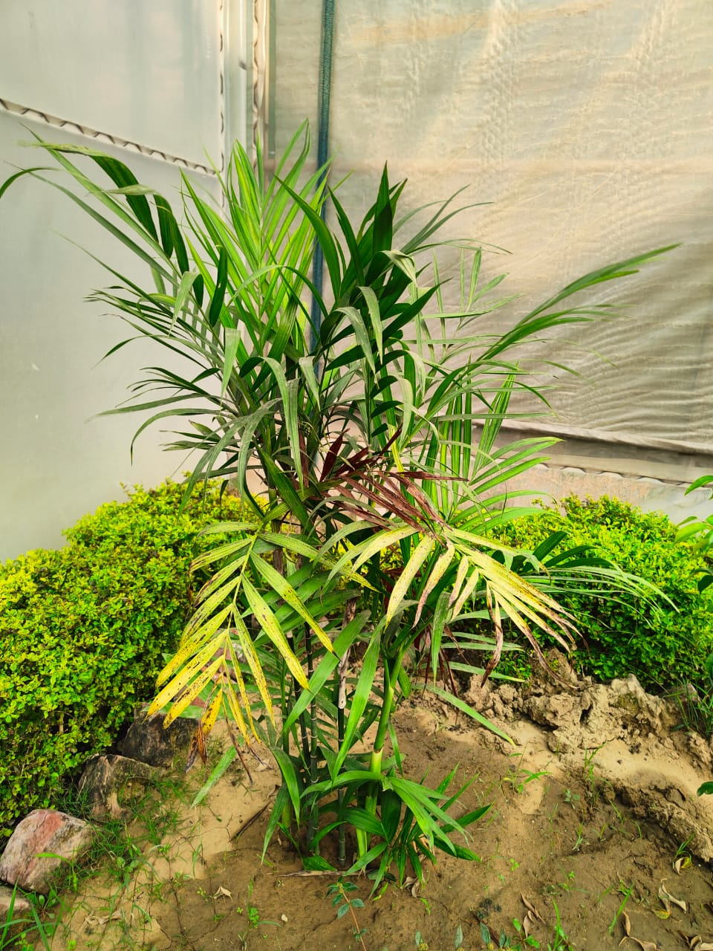
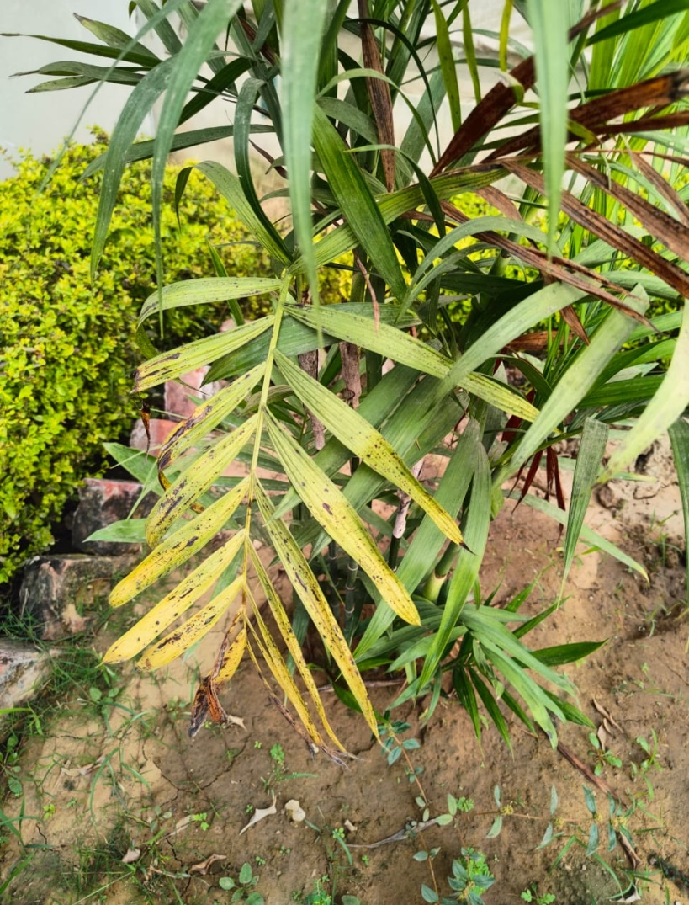
6.PALMS
Palm tree is here by Basal stem rot……

Slide 2
As we found in our research the disease is hindrence in the growth of a plant not only in our university but all over the world …..
So we want to proposed the idea of Disease detection technique by Deep learning or machine learning method….

Slide 3
SOLUTION

Slide 4
DISESASE DETECTION METHOD INTRODUCTION
In Agriculture, leaf diseases have grown to be a dilemma as it can cause a significant diminution in both the quality and quantity of agricultural yields. Thus, automated recognition of diseases on leaves plays a crucial role in the agriculture sector. This Crop Disease detection project is based on the same idea which can be used to detect disease in specific crops on which it is trained. In Agriculture sector plants or crops, cultivation has seen fast development in both the quality and quantity of food production. However, the presence of diseases on crops especially on leaves has hindered the quality of agricultural goods. This severe effect can disturb any nation's economy especially of those where 70% of the inhabitants rely on the products from the agricultural sector for their livelihood and endurance. This problem can be solved by the detection of crop diseases and to detect crop disease this project can be used. This project will diagnose the disease based on images of leaves.

Slide 5
MATERIALS & METHODS
As we all working on 6 crops or plants but here we discuss methodology of tomato disease detection on leaf-
In this study, plant village tomato leaf images dataset was used.All images were divided into 10 different classes, where one class is healthy and the other nine classes are unhealthy (such as- bacterial spot, early blight, leaf mold, septoria leaf spot, target spot, two-spotted spider mite, late bright mold, mosaic virus, and yellow leaf curl virus), and 9 unhealthy classes are categorized into five subgroups (namely-bacterial, viral, fungal, mold and mite disease).

Slide 6
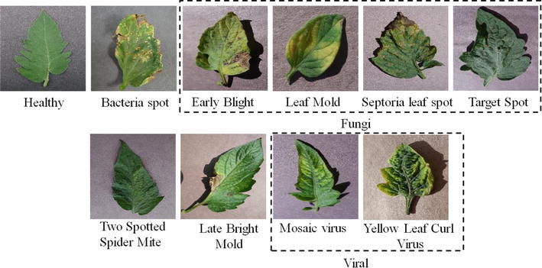
The various CNN network has input image size requirements. Thus, the images were resized to 299 × 299 for Inceptionv3 and 224 × 224 for Resnet18, MobilenetV2, and DenseNet201. Using the mean and standard deviation of the images of the dataset, z-score normalization was used to normalize the images. the input is convolved with filters called kernels, that is, a number of filters slide over the feature map of the previous layer, to produce output feature maps.

Slide 7
LITERATURE REVIEW
1. Shruthi U, Nagaveni V, Raghavendra B K proposed A review on machine learning classification techniques for plant disease detection shows different machine learning classification are used to detect the crop disease. The different classification methods are Artificial Neural Network (ANN) classification technique, K-nearest neighbor classification technique, Convolutional Neural Network classification, fuzzy classifier and Support Vector Machine (SVM) classification methods. From above mentioned techniques Convolutionsl Neural Network provides high accuracy compared to other methods and detect more number of diseases in multiple crops [1].
REFERENCES
Mrs. Shruti U, Dr.Nagaveni V, Dr.Raghavendra B K A review on machine learning classification techniques for plant disease detection 5th International Conference on Advanced Computing & Communication Systems (ICACCS) 2019.
2. Anitha proposed Rice disease detection using deep learning which proposes an automatic disease detection using deep neural network. The developed model is capable of detecting 3 different disease of paddy and also detect the healthy leaf image.The dataset was trained with three CNN architectures and achieved a high accuracy of 99.53% .
REFERENCES
V. Vanitha Rice disease detection using deep learning, International Journal of Recent Technology and Engineering (IJRTE) ,Vol 7,Issue- 5S3, Feb2019.

Slide 8
3.
disease identification and classification by integrating support vector machine with deep convolutional neural network represents a system to identify the rice disease and help the farmers to take proper decision to control the disease and also help them to increase production. They have built a AI model by integration of Support Vector Machine(SVM) with Deep Convolutional Neural Network(DCNN). Model identifies and classifies nine types of rice disease an accuracy of 97.5% .
REFERENCES
Md. Jahid Hasan, Shamim Mahbub, Md. Abu Nasim, Md. Shahin Alom Rice disease identification and classification by integrating support vector machine with deep convolutional neural network,2019
4.
Anuradha badge proposed Crop disease detection using Machine learning: Indian Agriculture how diseases affecting the less yield and how machine learning technique will help us to detect the disease and help the farmers to take necessary action. They used cannys edge detection algorithm for the efficient detection of crop disease by taking image of crop.
REFERENCESS
Anuradha badge Crop disease detection using Machine learning : Indian agriculture, International Research Journal of Engineering and Technology (IRJET) ,05issue :09, Sept 2018..

Slide 9
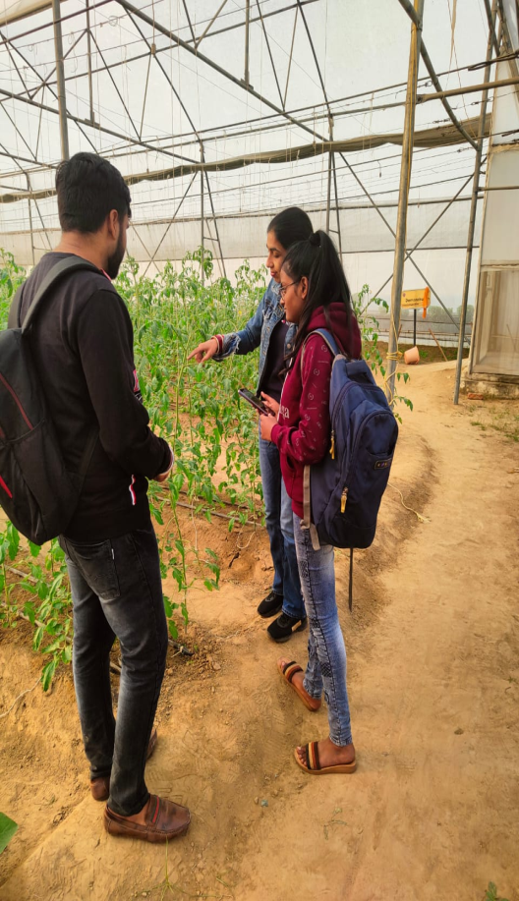
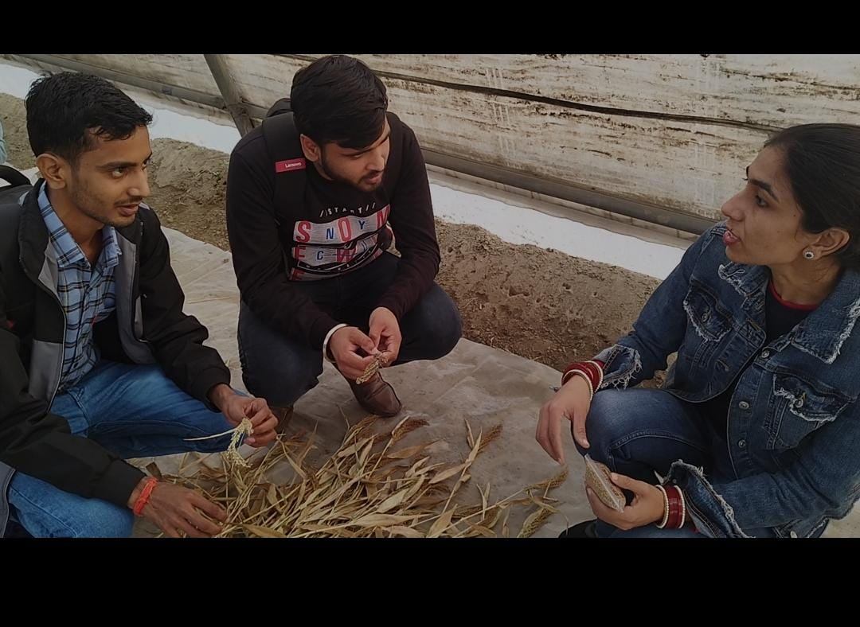
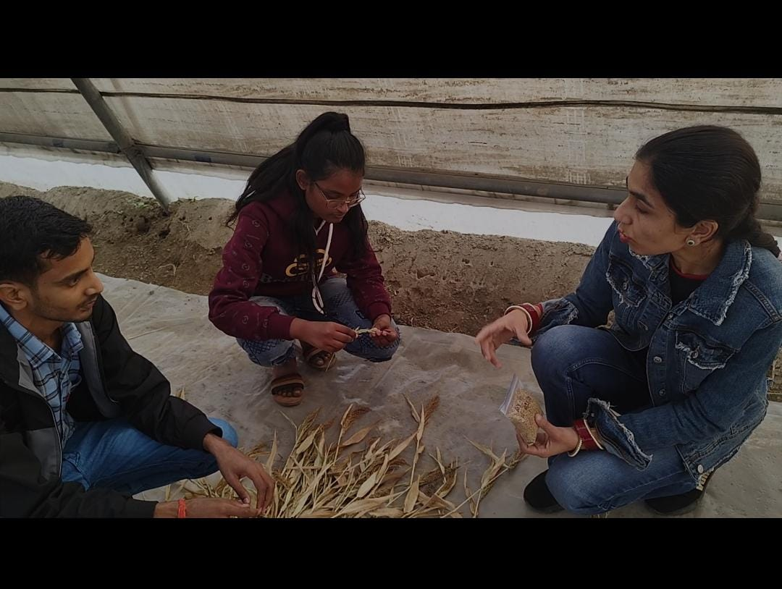
RESULTS & DISCUSSION
Here we have some data of LPU{LOVELY PROFESSIONAL UNIVERSITY } Agri-Farm[Poly-House] Where we interact with a food technology student and dicuss about millet a one of most famous crop of punjab as well as important in punjabi culture.

Slide 10
CONCLUSION
This project can be used for simplifying the process of crop disease detection. This project follows one touch process for detection of disease in crop if present. By detecting disease one can take steps for treatment of the same. This project will be beneficial on the specific crop category on which it is trained. This project can save a lot of time which is wasted on detection of diseases found in crop that too with good accuracy.

Slide 11
Farmers are facing the issues with Tomato crop disease identification and unable to find effective pesticide or insecticide to control the infected disease. We solve the above issue by developing a machine learning model using the Convolutional Neural Network (CNN) algorithm that detects the Rice Blast, Bacterial Blight and Healthy Tomato leaf images and provides the solution as insecticide or pesticides in order to control the Rice Blast and Bacterial Blight. We see that the system is robust, user friendly, fast and cost efficient result than existing method.

Slide 12
OUR WORK FOR SUSTAINABILITY DEVELOPMENT
ZERO HUNGER-”End hunger, achieve food security and improved nutrition and promote sustainable agriculture.”
IN THIS PROJECT OUR MAIN AIM IS FOOD SECURITY-
Food insecurity is what happens when the next meal is plagued by question marks. ‘When will I be able to eat again? Will this be enough to fuel me until then?
SO, , we can support farmers and stockists who share our dedication to sustainability!
Growing produce organically is kinder to the environment and promotes soil fertility that can
serve future crops. That is, when we grow and shop organic, we are supporting efforts to
maintain supplies and ensure the availability of more good quality food. Acknowledging our
impact on animals, global water supply, and the environment, as well as issues such as
climate change and increased demand that we may face, we are able to fight for ethicality in
our food, and for growth that does not harm the growth capacities of the farmers of the future

Slide 13
REFRENCES
TO WORK ON THIS WONDERFUL PROJECT WE USE SOURCES-
IJERT(INTERNATIONAL JOURNAL OF ENGINEERING RESEARCH AND TECHNOLOGY.
GIT-HUB…
AGRI-FARM IN LPU

Slide 14
NAME-ANVI YADAV
REG.NO-12203482
NAME-SUYASH CHAUBEY
REG.NO-12203518
NAME-SATYA KUMAR CHAUDHARY
REG.NO- 12203506

